Slide 1
Data Base Management System for an insurance company
Ozhogov Vladislav SE2002

Slide 2

Introduction Project purpose
The main goal of creating a DMBS for insurance company is to modify the work, since operating with data manually takes much time and resources. Processing data would be a lot easier since keeping track of documents even for an employee is a huge deal, so DMBS helps minimizing efforts and maximizing the profit.

Slide 3
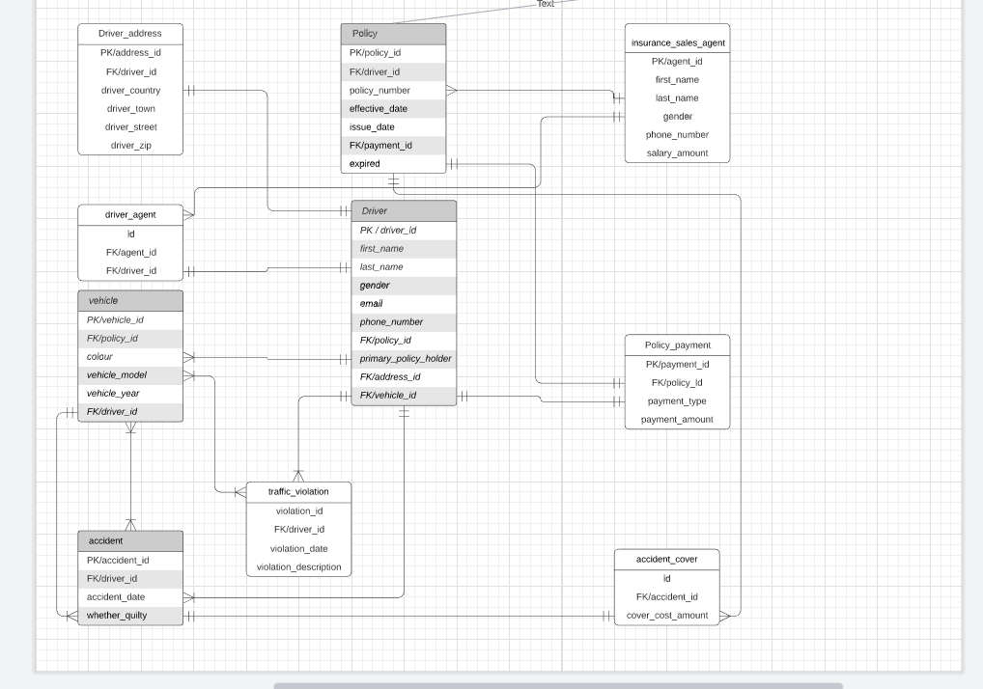
Entity Relationship Diagram

Slide 4
Business rules
Each driver has a unique policy and each policy is a property of only one driver.
Each driver can have multiple vehicles but vehicle is a property of only one driver.
Each driver can have multiple traffic violations.
Each driver has a history of car accidents which occurred in the past.
Each policy has a non-unique amount of payment.
Each driver has a non-unique address.
Multiple accidents can be connected with each vehicle.
Multiple vehicles can be connected with multiple accidents.
Each driver has one non-unique sales agent and each agent is connected with multiple drivers.
Each accident has a non-unique cover amount which would be paid to a driver if he was not guilty.

Slide 5
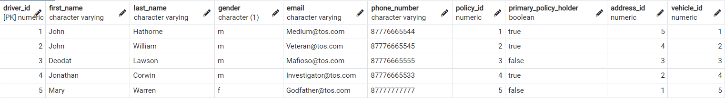
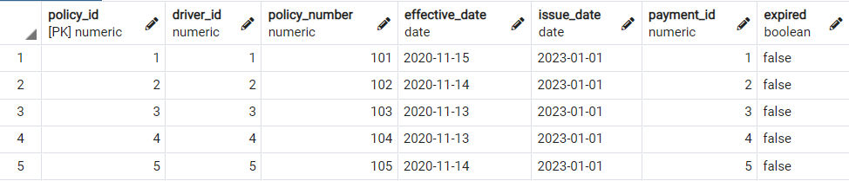
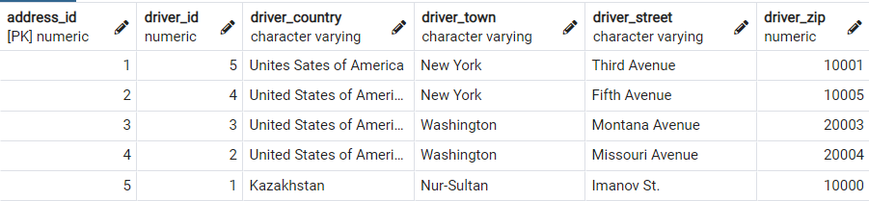
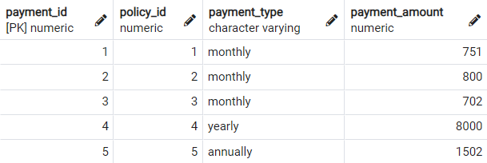
Inserted Data (Part 1)
Driver
Policy
Driver Address
Payment of policy

Slide 6
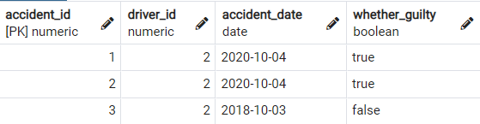
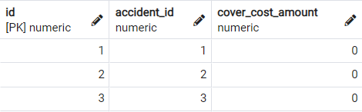
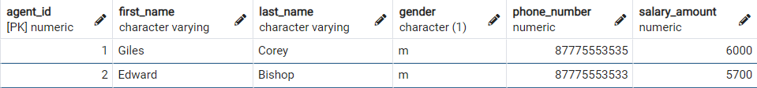
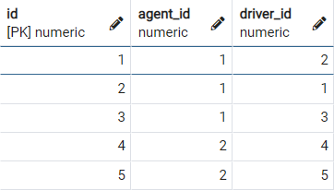
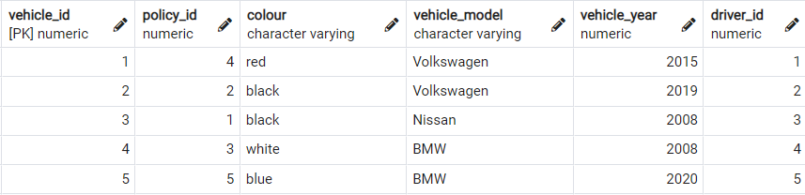
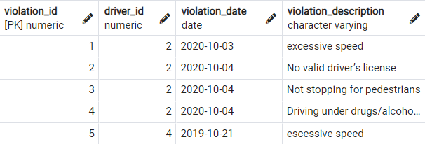
Inserted Data (Part 2)
Accident
Accident cover
Insurance sales agent
Driver’s agent
Vehicle
Violation record

Slide 7
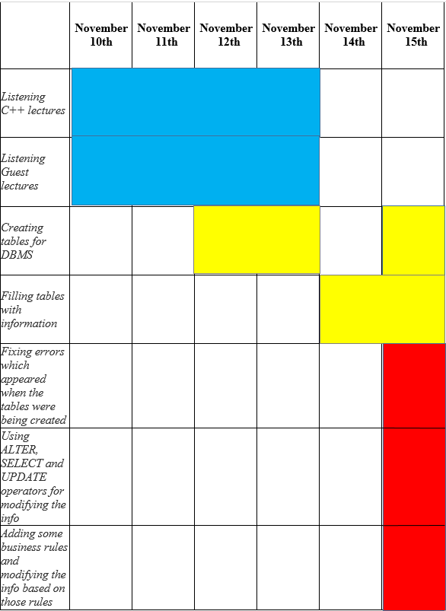
Gantt Chart

Slide 8
Conclusion
Benefits
- reducing efforts whilst increasing profit
- facilitation of keeping track of data
- facilitation of processing data
- modernization of the System 2. Possible improvements
- split the property and injury coverage
- declare the actual accident coverage
- keeping track of larger amount of data

